Slide 1
UNIT – IV
MACRO PROCESSORS

Slide 2
INTRODUCTION
A macro instruction (Macro) is a notational convenience for the programmer
  Allows the programmer to write short hand programs (modular programming).
The macro processor replaces each macro instruction with its equivalent block of instructions.
The macro processor is not concerned with the meaning of the involved statements during expansion.
The design of the macro processor is generally machine independent.

Slide 3
BASIC MACRO PROCESSOR FUNCTIONS
Directives used during usage of Macro:
  Macro: Indicates begin of Macro
  MEND: indicates end of Macro
Prototype for Macro:
  Each argument starts with Name and macro
  Parameter list
      .
      .
      MEND
BODY: The statement will be generated as the expansion of Macro

Slide 4
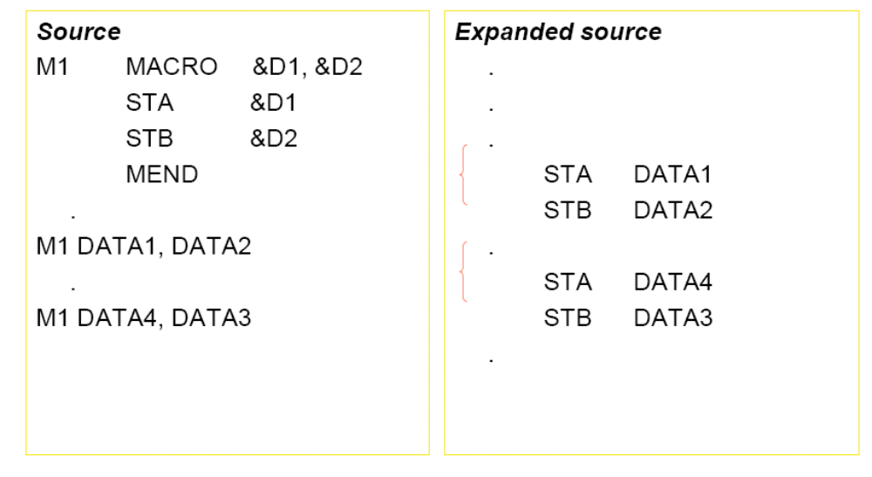
MACRO EXPANSION

Slide 5
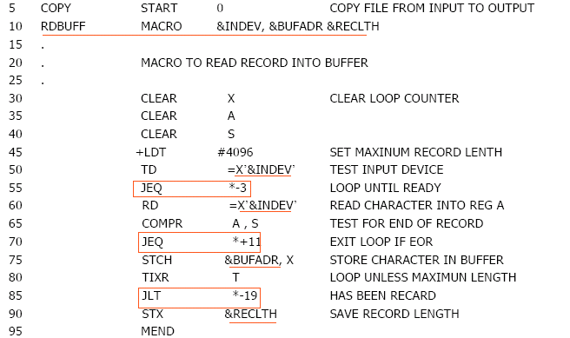
BASIC MACRO PROCESSOR FUNCTIONS

Slide 6
MACRO INVOCATION
A macro invocation statement (a macro call) gives the name of the macro instruction being invoked and the arguments to be used in expanding the macro.
  macro_name p1, p2, …
Difference between macro call and procedure call
  Macro call: statements of the macro body are expanded each time the macro is invoked.
  Procedure call: statements of the subroutine appear only one, regardless of how many times the subroutine is called.

Slide 7
MACRO INVOCATION
Question
  How does a programmer decide to use macro calls or procedure calls?
    From the viewpoint of a programmer
    From the viewpoint of the CPU

Slide 8
EXCHANGE THE VALUES OF TWO VARIABLES
void exchange(int a, int b) {
int temp;
temp = a;
a = b;
b = temp;
}
main() {
int i=1, j=3;
printf("BEFORE - %d %d\n", i, j);
exchange(i, j);
printf("AFTER - %d %d\n", i, j);
}
What’s the result?

Slide 9
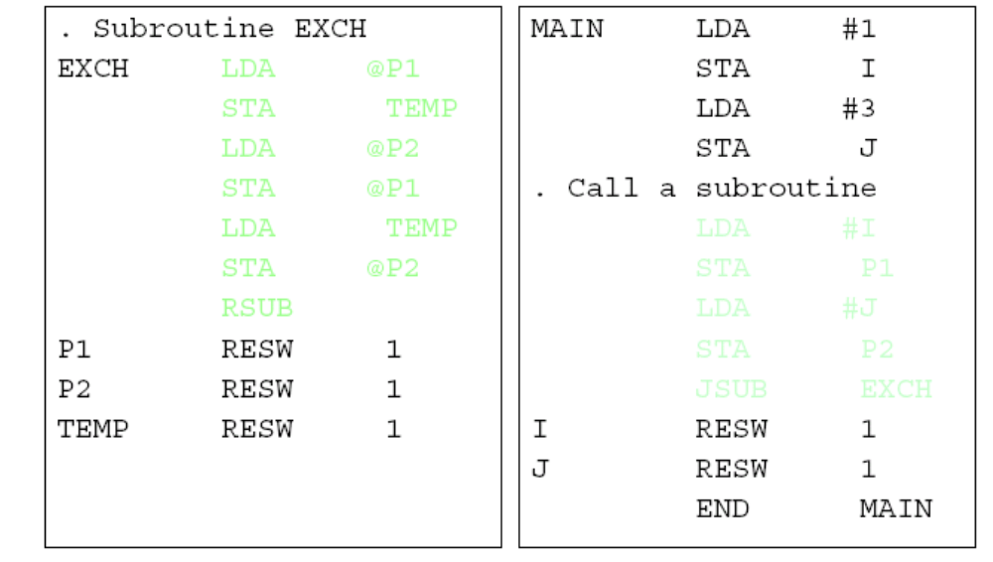
12 LINES OF ASSEMBLY CODE

Slide 10
SWAP TWO VARIABLES BY MACRO
#define swap(i,j) { int temp; temp=i; i=j; j=temp; }
main() {
int i=1, j=3;
printf("BEFORE - %d %d\n", i, j);
swap(i,j);
printf("AFTER - %d %d\n", i, j);
}

Slide 11
BASIC MACRO PROCESSOR FUNCTIONS
MAIN LDA #1
STA I
LDA #3
STA J
. Invoke a macro
LDA I
STA TEMP
LDA J
STA I
LDA TEMP
STA J
I RESW 1
J RESW 1
TEMP RESW 1
END MAIN

Slide 12
MACRO EXPANSION
Each macro invocation statement will be expanded into the statements that form the body of the macro.
Arguments from the macro invocation are substituted for the parameters in the macro prototype (according to their positions).
  In the definition of macro: parameter
  In the macro invocation: argument

Slide 13
MACRO EXPANSION
Comment lines within the macro body will be deleted.
Macro invocation statement itself has been included as a comment line.
The label on the macro invocation statement has been retained as a label on the first statement generated in the macro expansion.
  We can use a macro instruction in exactly the same
  way as an assembler language mnemonic.

Slide 14
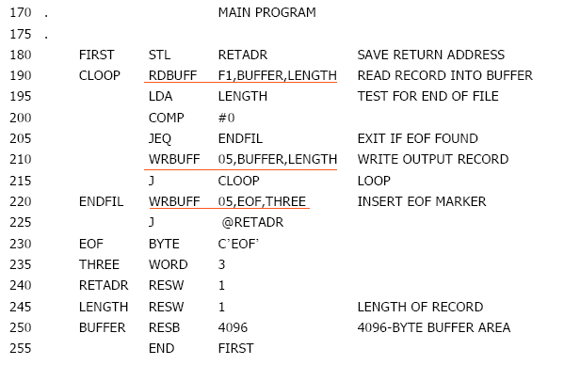
MACRO INVOCATION: A PROGRAM

Slide 15
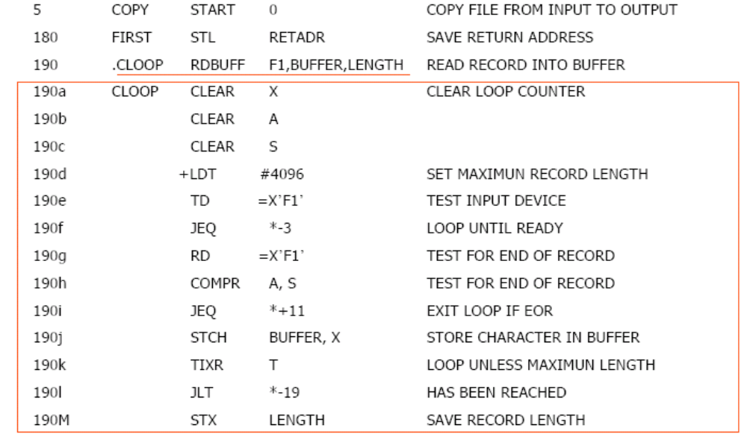
MACRO EXPANSION: A PROGRAM

Slide 16
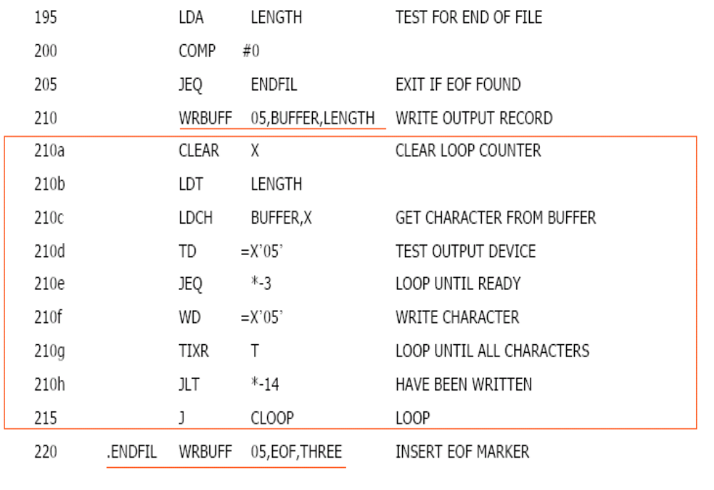
MACRO EXPANSION: A PROGRAM

Slide 17
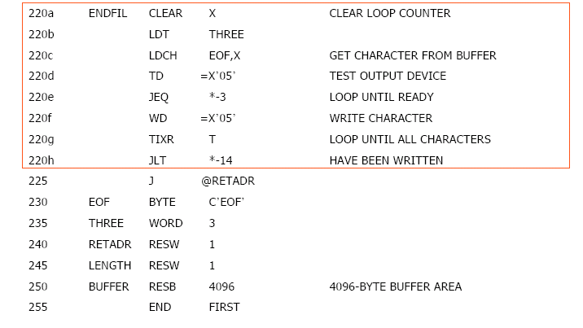
MACRO EXPANSION: A PROGRAM

Slide 18
NO LABEL IN MACRO BODY
Problem of the label in the body of macro:
  If the same macro is expanded multiple times at different places in the program …
  There will be duplicate labels, which will be treated as errors by the assembler.
Solutions:
  Do not use labels in the body of macro.
  Explicitly use PC-relative addressing instead.
    Ex, in RDBUFF and WRBUFF macros,

Slide 19
TWO-PASS MACRO PROCESSOR
You may design a two-pass macro processor
  Pass 1:
    Process all macro definitions
  Pass 2:
    Expand all macro invocation statements

Slide 20
TWO-PASS MACRO PROCESSOR
However, one-pass may be enough
  Because all macros would have to be defined during the first pass before any macro invocations were expanded.
    The definition of a macro must appear before any statements that invoke that macro.
  Moreover, the body of one macro can contain definitions of other macros.

Slide 21
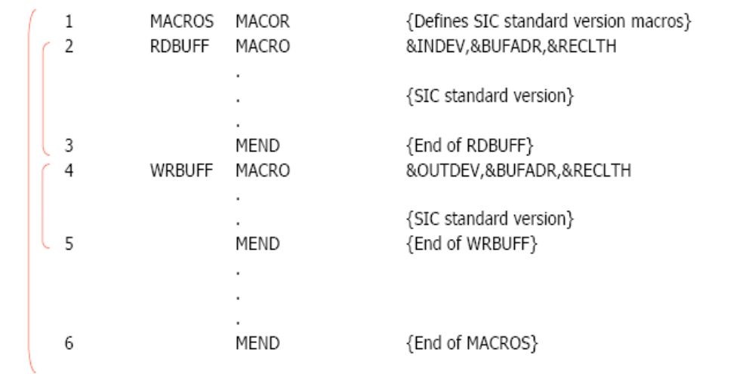
EXAMPLE OF RECURSIVE MACRO DEFINITION
MACROS (for SIC)
  Contains the definitions of RDBUFF and WRBUFF written in SIC instructions.

Slide 22
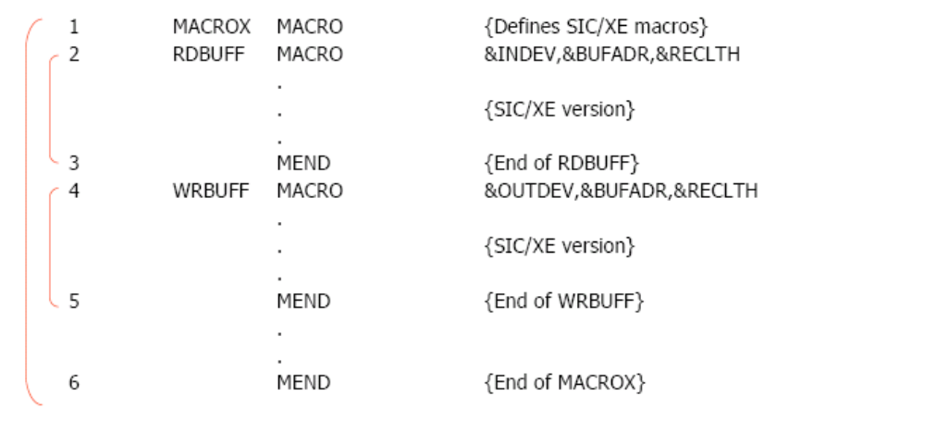
RECURSIVE MACRO DEFINITION
MACROX (for SIC/XE)
  Contains the definitions of RDBUFF and WRBUFF written in SIC/XE instructions.

Slide 23
MACRO DEFINITION: AN EXAMPLE
A program that is to be run on SIC system could invoke MACROS whereas a program to be run on SIC/XE can invoke MACROX.
However, defining MACROS or MACROX does not define RDBUFF and WRBUFF.
  These definitions are processed only when an invocation of MACROS or MACROX is expanded.

Slide 24
ONE-PASS MACRO PROCESSOR
A one-pass macro processor that alternate between macro definition and macro expansion in a recursive way is able to handle recursive macro definition.
Restriction
  The definition of a macro must appear in the
  source program before any statements that
  invoke that macro.
  This restriction does not create any real
  inconvenience.

Slide 25
DATA STRUCTURE FOR ONE-PASS MACRO PROCESSOR
DEFTAB (definition table)
  Stores the macro definition including macro
  prototype and macro body
  Comment lines are omitted.
  References to the macro instruction parameters are
  converted to a positional notation for efficiency in
  substituting arguments.

Slide 26
DATA STRUCTURE FOR ONE-PASS MACRO PROCESSOR
NAMTAB
  Stores macro names
  Serves as an index to DEFTAB
  Pointers to the beginning and the end of the
  macro definition (DEFTAB)
ARGTAB
  Stores the arguments of macro invocation
  according to their positions in the argument list
  As the macro is expanded, arguments from
  ARGTAB are substituted for the corresponding
  parameters in the macro body.

Slide 27
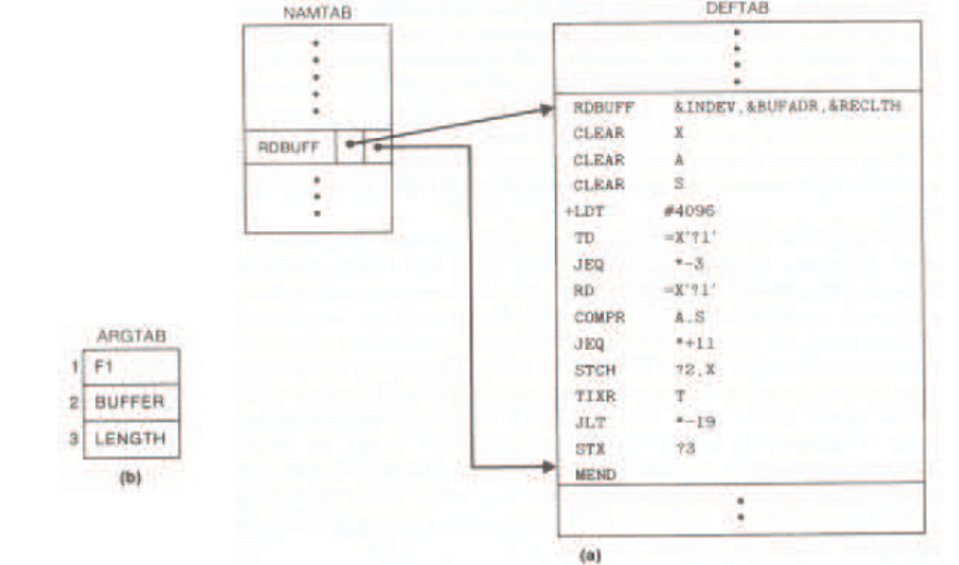
DATA STRUCTURE

Slide 28
NEXT – AFTER A BREAK
Algorithms
Nested macros
Comparison of different macro design
Machine-Independent macro features

Slide 29
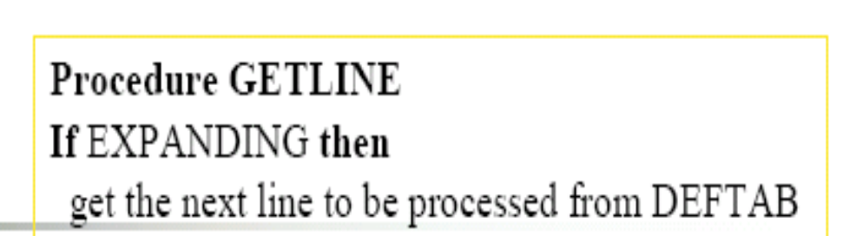
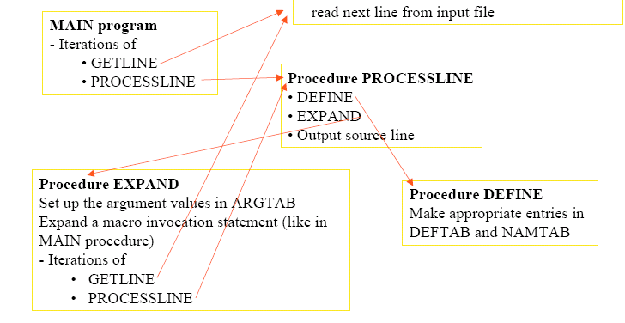
ALGORITHM

Slide 30
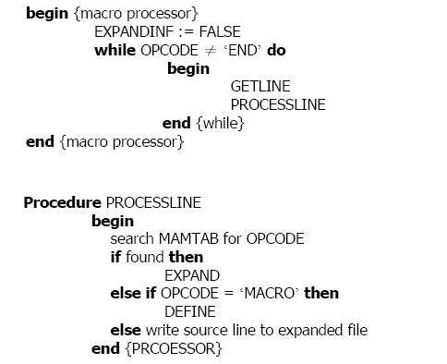
ALGORITHM

Slide 31
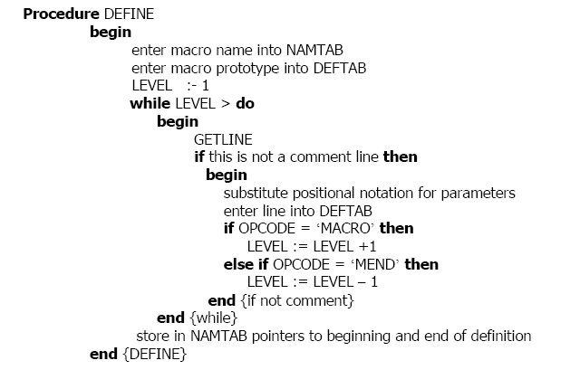
ALGORITHM

Slide 32
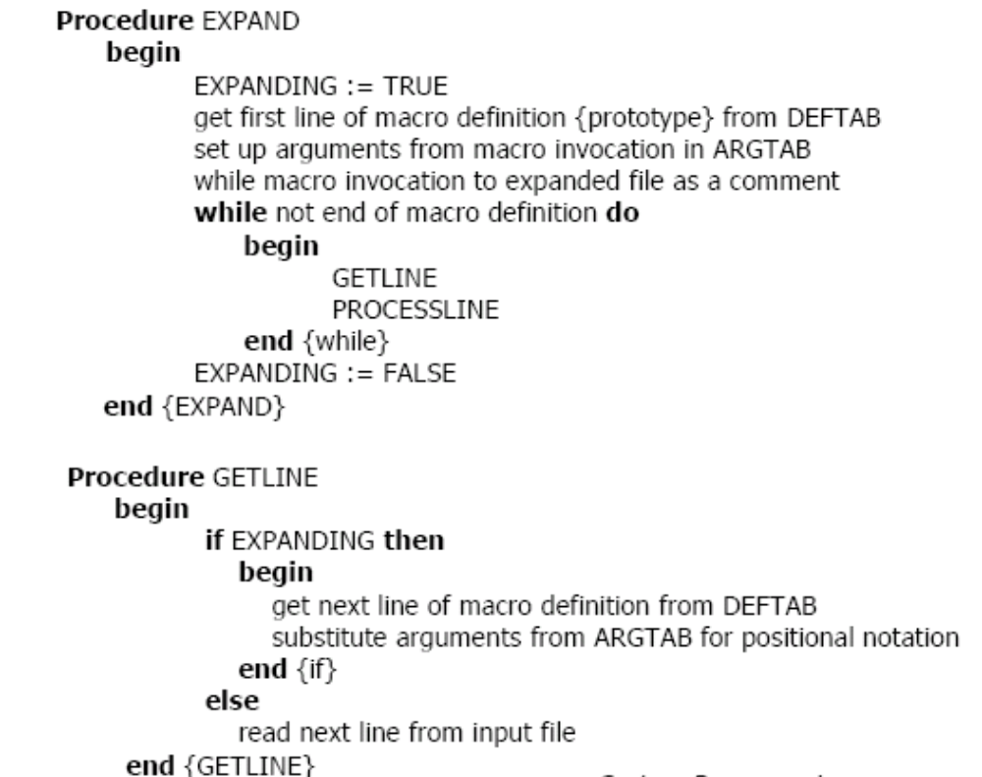
ALGORITHM

Slide 33
HANDLING NESTED MACRO
In DEFINE procedure
  When a macro definition is being entered into
  DEFTAB, the normal approach is to continue
  until an MEND directive is reached.
  This would not work for nested macro definition because the first MEND encountered in the inner macro will terminate the whole macro definition process.

Slide 34
HANDLING NESTED MACRO
To solve this problem, a counter LEVEL is used to keep track of the level of macro definitions.
  Increase LEVEL by 1 each time a MACRO directive is read.
  Decrease LEVEL by 1 each time a MEND directive is read.
  A MEND terminates the whole macro definition process when LEVEL reaches 0.
  This process is very much like matching left and right parentheses when scanning an arithmetic expression.

Slide 35
COMPARISON OF MACRO PROCESSOR DESIGN
One-pass algorithm
Every macro must be defined before it is called
One-pass processor can alternate between macro definition and macro expansion
Nested macro definitions are allowed but nested calls are not

Slide 36
COMPARISON OF MACRO PROCESSOR DESIGN
Two-pass algorithm
  Pass1: Recognize macro definitions
  Pass2: Recognize macro calls
  Nested macro definitions are not allowed

Slide 37
MACHINE-INDEPENDENT MACRO PROCESSOR FEATURES

Slide 38
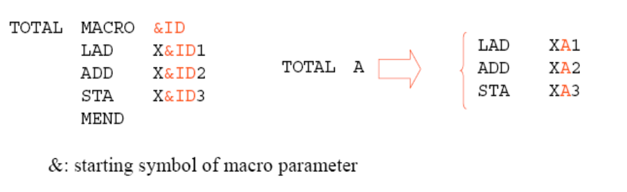
CONCATENATION OF MACRO PARAMETERS
Concatenation parameters with other character strings.
  Used when a program consists a set of series of variables.

Slide 39
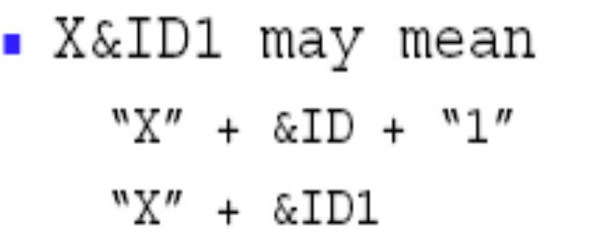
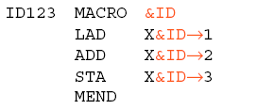
COMPARISON OF MACRO PROCESSOR DESIGN
Ambiguity problem
  If &ID and &ID1 are parameters
Solution to this ambiguity problem
  Use a special concatenation operator “->” to specify the end of the parameter

Slide 40
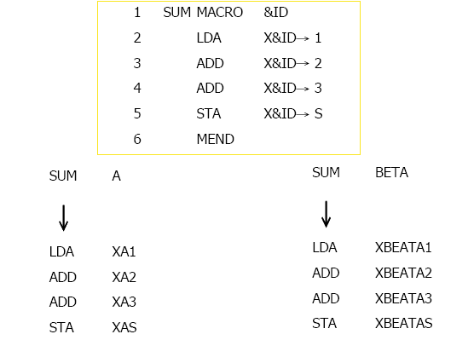
COMPARISON OF MACRO PROCESSOR DESIGN

Slide 41

GENERATING UNIQUE LABELS
Labels in the macro body may cause “duplicate labels” problem if the macro is invocated and expanded multiple times. Ex:
Use of relative addressing at the source statement level is very inconvenient, error-prone, and difficult to read.

Slide 42
GENERATING UNIQUE LABELS
Let the macro processor generate unique
labels for each macro invocation and
expansion.
  During macro expansion, the $ will be replaced with
  $xx, where xx is a two-character alphanumeric counter
  of the number of macro instructions expanded.
  xx=AA,AB,AC,…..
    This allows 1296 macro expansions in a single program.

Slide 43
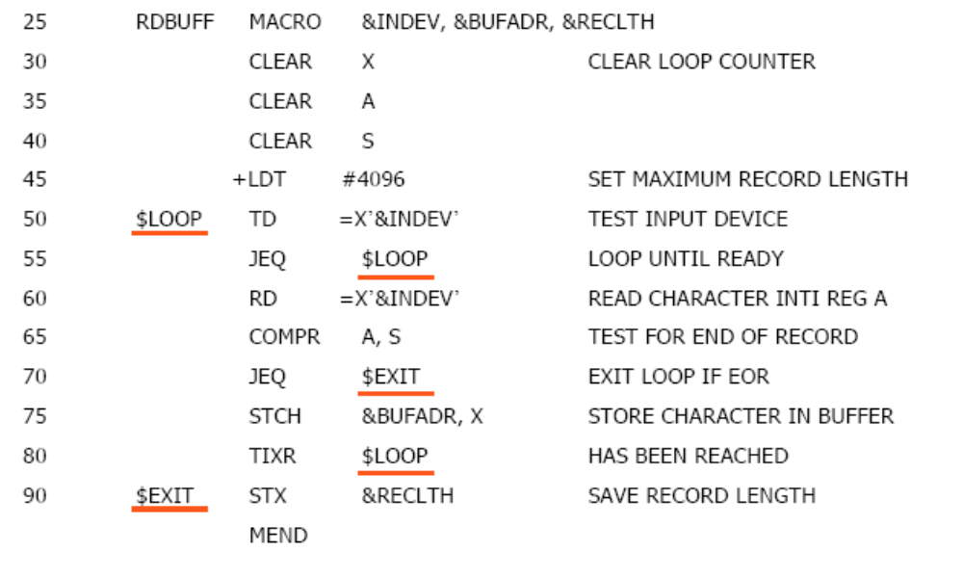
GENERATION OF UNIQUE LABELS

Slide 44
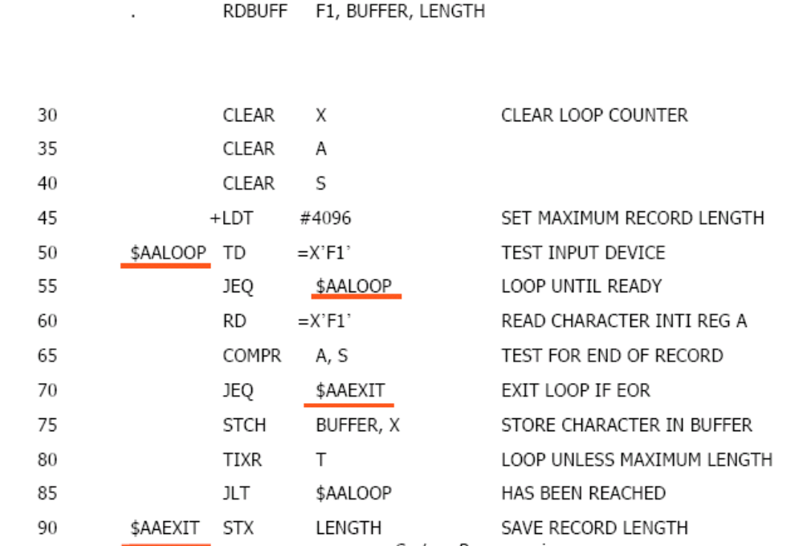
GENERATION OF UNIQUE LABELS

Slide 45
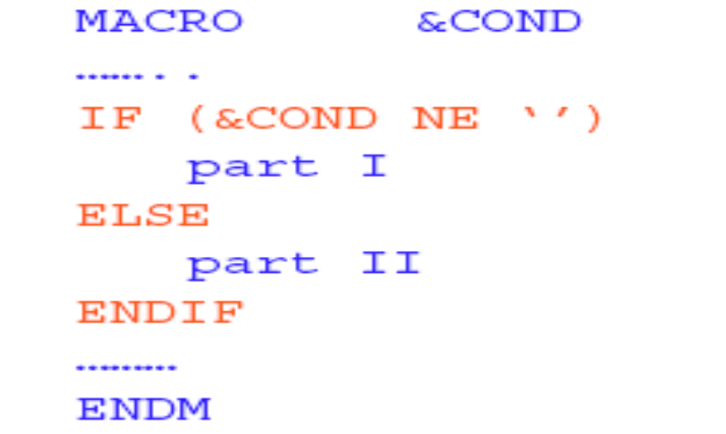
GENERATION OF UNIQUE LABELS
Conditional assembly depends on parameters provided
Part I is expanded if condition part is true, otherwise part II is expanded
Compare operator: NE, EQ, LE, GT

Slide 46
GENERATION OF UNIQUE LABELS
Begins with “&” but is not a macro instruction
parameter
Can be used to store working values during
the macro expansion
  -Store the evaluation result of Boolean expression
    -Control the macro-time conditional structures
Be initialized to a value of 0
Be set by a macro processor directive, SET
    Ex: &EORCK SET 1
    &EORCTR SET &EORCTR + 1

Slide 47
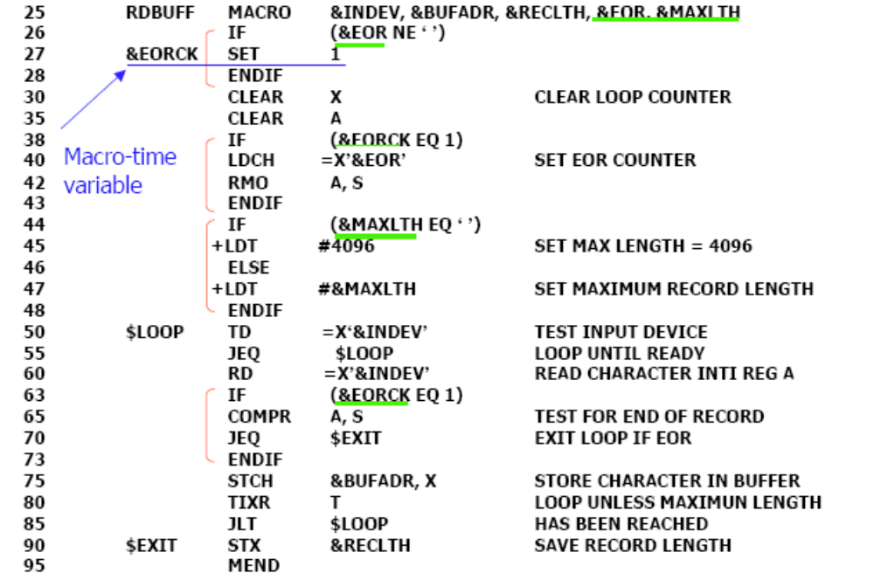
GENERATION OF UNIQUE LABELS

Slide 48
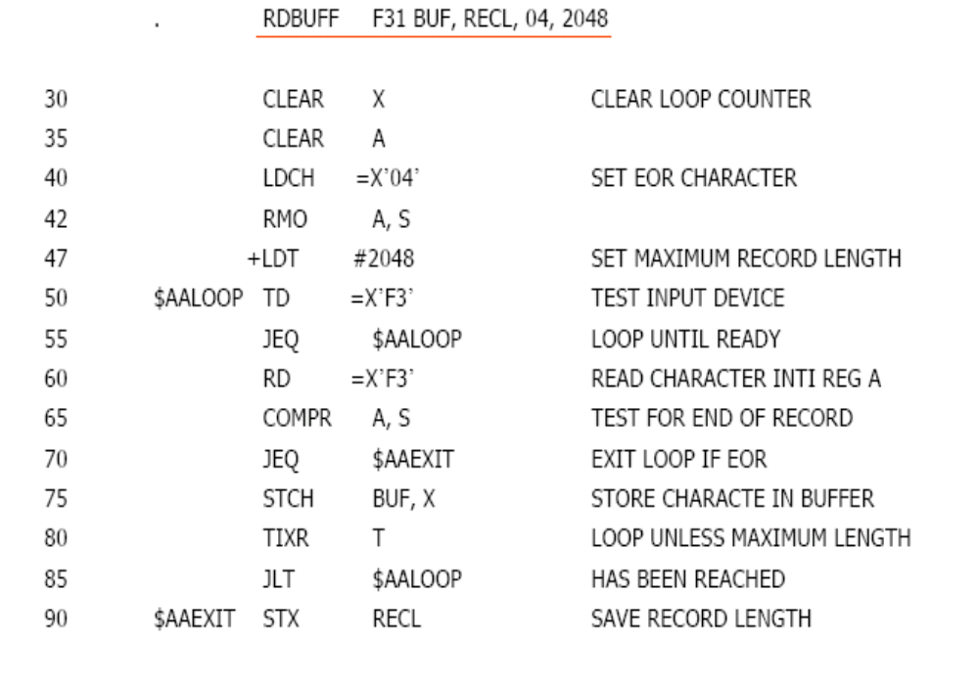
GENERATION OF UNIQUE LABELS

Slide 49
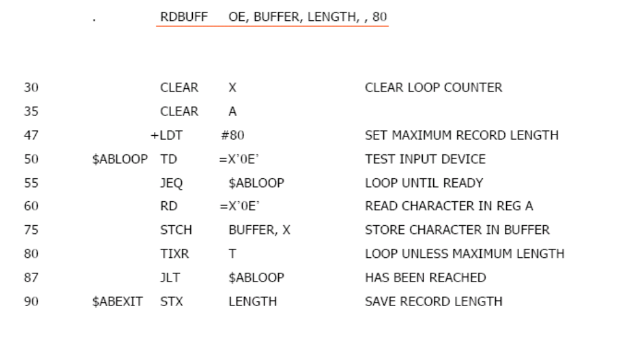
GENERATION OF UNIQUE LABELS

Slide 50
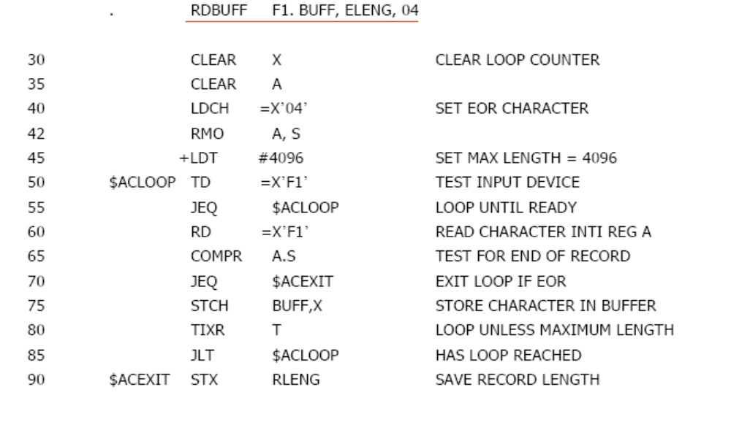
GENERATION OF UNIQUE LABELS

Slide 51
MACRO-TIME LOOPING
      WHILE ( cond )
      ……
      ENDW
Macro processor function
  %NITEMS: The number of members in an argument list
The execution of testing of IF/WHILE, SET,
  - %NITEMS() occurs at macro expansion time

Slide 52
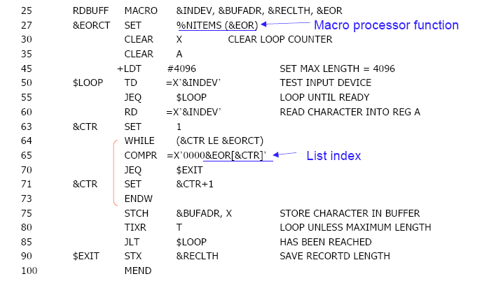
USE OF MACRO-TIME LOOPING STATEMENT

Slide 53
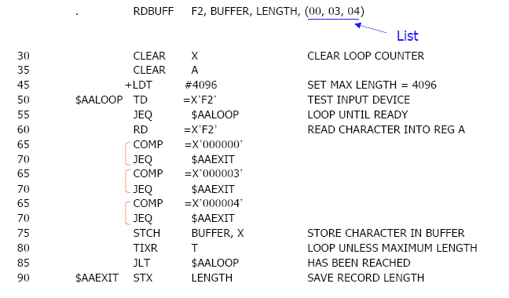
USE OF MACRO-TIME LOOPING STATEMENT

Slide 54
IMPLEMENTATION-CONDITIONAL MACRO EXPANSION
IF-ELSE-ENDIF structure
  The macro processor must maintain a symbol table
    -This table contains the values of all macro-time variables used.
    - Entries in this table are made or modified when SET statements are processed.
    - This table is used to look up the current value of a macro-time variable whenever it is required.

Slide 55
IMPLEMENTATION-CONDITIONAL MACRO EXPANSION
When an IF statement is encountered during the expansion of a macro, the specified Boolean expression is evaluated.
TRUE
  The macro processor continues to process lines from DEFTAB until it encounters the next ELSE or ENDIF statement.
  If ELSE is encountered, then skips to END
FALSE
  The macro processor skips ahead in DEFTAB until it finds the next ELSE or ENDIF statement.

Slide 56
IMPLEMENTATION-CONDITIONAL MACRO EXPANSION
When an IF statement is encountered during the expansion of a macro, the specified Boolean expression is evaluated.
    -TRUE
      The macro processor continues to process lines from DEFTAB until it encounters the next ENDW statement.
      When ENDW is encountered, the macro processor returns to the preceding WHILE, re-evaluates the Boolean expression, and takes action based on the new value.

Slide 57
IMPLEMENTATION-CONDITIONAL MACRO EXPANSION
FALSE
  -- The macro processor skips ahead in DEFTAB until it finds the next ENDW statement and then resumes normal macro expansion.

Slide 58
SUMMARY
Algorithms
Nested macros
Comparison of different macro design
Machine-Independent macro features
Implementation of conditional macros

Slide 59
NEXT – AFTER A BREAK
Keyword macro parameters
Recursive Macros
Line-by-Line Macros
Integrated Macros

Slide 60
USE OF MACRO-TIME LOOPING STATEMENT

Slide 61
IMPLEMENTATION-CONDITIONAL MACRO EXPANSION
IF-ELSE-ENDIF structure
  The macro processor must maintain a symbol
  table
    Entries in this table are made or modified when SET statements are processed.
    This table is used to look up the current value of a macro-time variable whenever it is required.
    This table contains the values of all macro-time variables used.

Slide 62
IMPLEMENTATION-CONDITIONAL MACRO EXPANSION
When an IF statement is encountered during the expansion of a macro, the specified Boolean expression is evaluated.
  TRUE
        The macro processor continues to process lines from DEFTAB until it encounters the next ELSE or ENDIF statement.
        If ELSE is encountered, then skips to ENDIF
  FALSE
      The macro processor skips ahead in DEFTAB until it finds the next
        ELSE or ENDIF statement.

Slide 63
IMPLEMENTATION-CONDITIONAL MACRO EXPANSION
WHILE-ENDW structure
  When an WHILE statement is encountered during the expansion of a macro, the specified Boolean expression is evaluated.
  TRUE
    -- The macro processor continues to process lines from DEFTAB until it encounters the next ENDW statement.
    -- When ENDW is encountered, the macro processor returns to the preceding WHILE, re-evaluates the Boolean expression, and takes action based on the new value.

Slide 64
IMPLEMENTATION-CONDITIONAL MACRO EXPANSION
FALSE
  -- The macro processor skips ahead in DEFTAB until it finds the next ENDW statement and then resumes normal macro expansion.

Slide 65
KEYWORD MACRO PARAMETERS
Keyword macro parameters
  Positional parameters and arguments are associated according to their positions in the macro prototype and invocation.
  If an argument is to be omitted, a null argument should be used to maintain the proper order in macro invocation:
  Ex: XXX MACRO &P1, &P2, …., &P20, ….
  XXX A1, A2,,,,,,,,,,…,,A20,…..

Slide 66
KEYWORD MACRO PARAMETERS
It is not suitable if a macro has a large number of parameters, and only a few of these are given values in a typical invocation.

Slide 67
KEYWORD MACRO PARAMETERS
Keyword Parameters
  Each argument is written with the keyword that names the corresponding parameter.
  Argument may appear any order.
  Null arguments are no longer required to be used.
  It is easier, less error prone and readable form to have keyword parameter than positional parameter.

Slide 68
KEYWORD MACRO PARAMETERS
Keyword Parameters
  Each argument is written with the keyword that names the corresponding parameter.
  Argument may appear any order.
  Null arguments are no longer required to be used.
  It is easier, less error prone and readable form to have keyword parameter than positional parameter.
    Ex P1=A1, P2=A2, … P20=A20

Slide 69
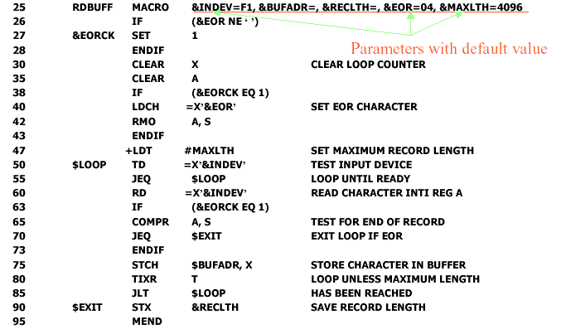
USE OF KEYWORD MACRO PARAMETERS

Slide 70
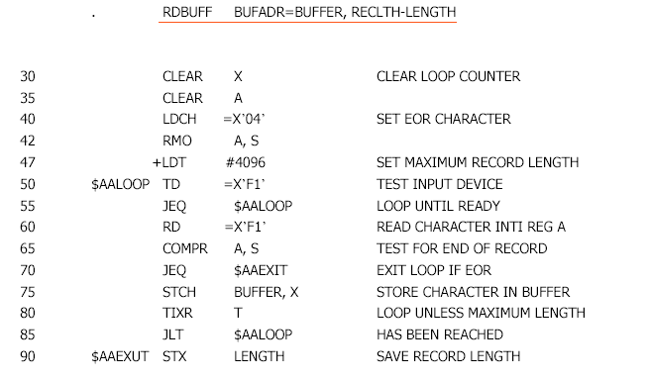
USE OF KEYWORD PARAMETERS IN MACRO

Slide 71
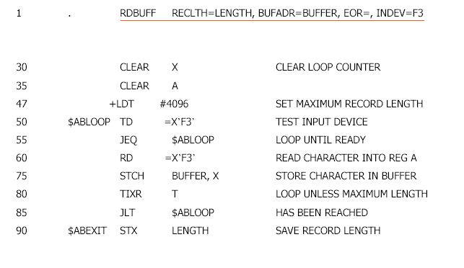
USE OF KEYWORD PARAMETERS IN MACRO

Slide 72
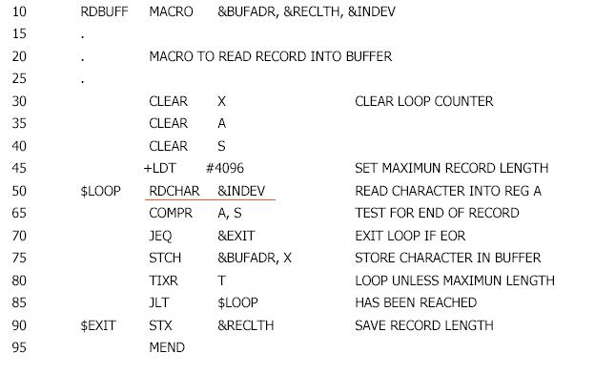
RECURSIVE MACRO EXPANSION

Slide 73
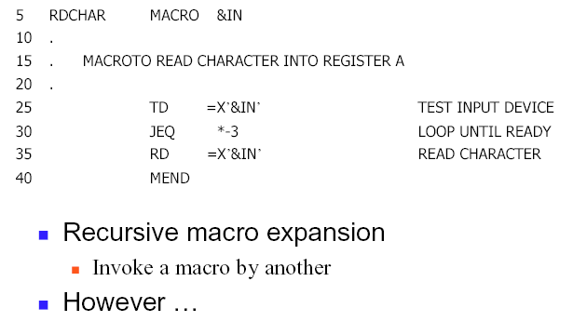
RECURSIVE MACRO EXPANSION

Slide 74
PROBLEM OF RECURSIVE MACRO PARAMETERS
Previous Macro Design Doesn’t take care
of recursive macro expansion.
  Problems:
    When procedure EXPAND is called recursively the invocation argument in the ARGTAB will be overwritten.
    The boolean variable Expand would set to false when the inner macro expansion is completed without having an idea that the it is part of another outer macro whose expansion is still not completed.

Slide 75
PROBLEM OF RECURSIVE MACRO PARAMETERS
Previous Macro Design Doesn’t take care
of recursive macro expansion.
  Solutions:
    Write the macro processor in a programming language which automatically takes care of the recursive calls thus retaining the local variables.
    If written in a language without recursion support, use a stack to take care of pushing and popping the local variables and return addresses thus retaining their values.

Slide 76
GENERAL PURPOSE MACRO PROCESSORS
  Macro processor that do not depend on any particular language, can be used with variety of languages.
  Pros
    Programmers do not need not learn any macro language.
    Although its development costs is little high than those for the language specific macro processor, but these macros does not need to be repeated for every language.

Slide 77
GENERAL PURPOSE MACRO PROCESSORS
  Macro processor that do not depend on any particular language, can be used with variety of languages.
  Cons
    Large number of details must be dealt within a programming language.
      Situations in which normal macro parameter substitution should not occur, e.g., comments.
      Facilities for grouping together terms, expressions, or statements
      Tokens, e.g., identifiers, constants, operators, keywords.
      Syntax must be consistent with the programming language.

Slide 78
MACRO PROCESSING WITHIN LANGUAGE TRANSLATORS
  Macro processor discussed so far are preprocessors that
    Process macro definitions
    Expand macro invocation
    Produces an expanded version of the macro at the place of the call and then use it by the assembler or the compiler.
  Macro processing functions can be combined with the language translators.
    Line-by-line macro processors
    Integrated macro processors

Slide 79
LINE-BY-LINE MACRO PROCESSORS
  Used as sort of input routine the assembler or compiler.
    Read source program.
    Handle macro definition and expand the invocation.
    Pass output lines to the assembler or compiler.
  Benefits
    Avoid making an extra pass over the source program.
    Data structures required by the translators and the macro processor can be kept same.
    Utility subroutines by the translators and the macros can be kept same.
      Scanning input lines, Searching tables.

Slide 80
INTEGRATED MACRO PROCESSORS
  An integrated macro processor can make use of any information about the source program that is extracted by the language translators
  An integrated macro processor can support macro instructions that depend upon the context in which they occur.

Slide 81
INTEGRATED MACRO PROCESSORS
  Definitions and invocations of macros are handled by a preprocessor, which is generally not integrated with the rest of the compiler.
  Example
        #DEFINE NULL 0
        #DEFINE EOF (-1)
        #DEFINE EQ ==
        #DEFINE ABSDIF (x, y) {X>Y? X-Y:Y-X}

Slide 82
INTEGRATED MACRO PROCESSORS
  Parameter substitutions are not performed within quoted.
  #define DISPLAY( EXPR) printf(“ EXPR= %d\ n”, EXPR)
Example
  DISPLAY( I* J+ 1) ==> printf(“ EXPR = %d\ n”, I* J+ 1)

Slide 83
INTEGRATED MACRO PROCESSORS
  Recursive macro definitions or invocations
  After a macro is expanded, the macro processor rescans the text that has been generated, looking for more macro definitions or invocations.
  Macro cannot invoke or define itself recursively.
  Example
  DISPLAY( ABSDIFF( 3, 8))
  SCANS
  printf(“ ABSDIFF( 3, 8)” “= %d\ n”, ABSDIFF( 3, 8))
  RESCANS
  printf(“ ABSDIFF( 3, 8)” “= %d\ n”, ( (3)>( 8) ? (3) -
  (8) : (8)-( 3) ))

Slide 84
ANSI C MACRO LANGUAGE
  Conditional compilation statements
  Example 1
        #ifndef BUFFER_ SIZE
        #define BUFFER_ SIZE 1024
        #endif
  Example 2
  #define DEBUG 1
  :
  #if DEBUG == 1
  printf(…) /* debugging outout */
  #endif

Slide 85
MACRO MACRO PROCESSOR
  ABSDIF J,K
    MOV AX,J
    SUB AX, K
    JNS ??0000
    NEG AX
    ??0000:

Slide 86
MACRO MACRO PROCESSOR
  ABSDIF MACRO OP1, OP2, SIZE
      LOCAL EXIT
      IFNB <SIZE>
      IFDIF <SIZE> <E>
      ;ERR
      EXITM
      ENDIF
      ENDIF
      MOV SIZEE&AX, OP1
      SUB SIZE&AX, OP2
      JNS EXIT
      NEG SIZE&AX
      EXIT:
      ENDM

Slide 87
SUMMARY
Algorithms
Nested macros
Comparison of different macro design
Machine-Independent macro features
Implementation of conditional macros

